Slide 1
PC-1 Revision Punjab Socio-Economic Registry (PSER) Revised Cost: Rs. 5,069.052 million PDWP 11/03/2025

Slide 2
Project Profile
1. | Name of the Project | Punjab Socio-Economic Registry (PSER)
2. | Location | All across Punjab
3. | Sponsoring | Planning & Development Board
4. | Executing Agency | Implementation partners: Punjab Social Protection Authority (PSPA) Bureau of Statistics (BOS) The Urban Unit Punjab Information Technology Board (PITB) District Administration
5. | Operation & Maintenance | PSPA (lead agency) and other implementing partners
6. | Cost | Rs. 2,450.894 million
8. | Gestation Period | December 2024-June 2025

Slide 3
Objectives
The objectives of PSER are as under: To develop a comprehensive and dynamic socioeconomic profile of all the citizens of Punjab province To act as a planning tool for resource allocation decision making and evidence-based policy making. To help in improved identification of the prospective beneficiaries for all welfare programs of the Government of the Punjab
Notes:
3

Slide 4
Progress
4,387 registration interns are hired by DCs, with a monthly salary of Rs. 50,000 for 5 months.
Ramazan Drive along with Communication Campaign re-started on 18thDecember 2024.
The data of 3.217 million families registered in PSER with PMT up to 50 has been shared with PITB for the Nighaban Ramzan.
7.836 million families registered in PSER till 11th March 2025.

Slide 5
Justification for the Revision
The development and maintenance of PSER is a highly complex and detail-oriented work requiring specialised and dedicated HR and updated IT infrastructure The original PC-1 was prepared for the period December 24-June 25 to facilitate the initial prototype of the PSER for Nigehban Ramzan However, the expansion of the PSER and start of the door-to-door survey of the entire Punjab is not possible with the current institutional and financial arrangements
Notes:
5

Slide 6
Major Changes in the PC-1
Hiring of dedicated staff and establishment of dedicated units at IPs and P&D level Procurement of required IT infrastructure Longer gestation period given up-coming activities (door-to-door survey) and continuation maintenance and update of data. Revised costs due to longer gestation period
Notes:
6

Slide 7
Revised Project Profile
 |  | New provision | Remarks
1 | Executing Agency | Planning & Development Board via Implementation Support Unit (ISU) and implementation partners: Punjab Social Protection Authority (PSPA) Bureau of Statistics (BOS) The Urban Unit Punjab Information Technology Board (PITB) District Administration | Added ISU
2 | Cost | Rs. 5,069.052 million for 3 years | 2,618.158 additional allocation (Details follow)
3 | Gestation period | Till June 2027 (3 years) | Extended by 2 years

Slide 8
Governance Structure
PSER Institutional Framework
PROGRAM STEERING COMMITTEE
GOVERNANCE STRUCTURE
District PSER Committees
CORE WORKING GROUP
ISU-P&D
PSPA
PITB
URBAN UNIT
BOS
Rs 81.79 million
Rs 3,314.36 million
Rs 635.66 million
Rs 227.63 million
Rs 9.62 million
Coordination and Reporting
Planning, Implementation, and Monitoring
IT support
Field Verifications
Technical support to UU
IMPLEMENTATION
STRUCTURE
Perform sample-based verification of data collected through desk and self-registration.
To perform the overall coordination of the program.
Ensure compliance of all activities by the IPs.
Assist in timely release of funds to the IPs.
Through its PIU:
Develop, test, and deploy software for PSER
Provide IT support to the registration desks
Provide and manage the hosting environment for the PSER
Establish integration with NADRA and other administrative sources for verification
Take data sharing and security measures
Assist PSPA in designing the PSER registration form and training.
Supporting the Urban Unit in field verifications.
Through its PMU:
Act as a lead agency and custodian of the PSER
Develop PMT formula and registration form
Manage registrations through LG & CD dept
Run media campaigns
Payments for data validation/acquisition (e.g., to NADRA and PLRA),
consultancies etc.
District Administration
Rs81.79 million
All implementing partners will be independent in terms of hirings, procurements, and financials.

Slide 9
Overall Cost
Sr No. | Name of the Executing & Implementation Agency | Estimated Cost (Rs million) | % Share | Duration
1 | Urban Unit | 227.63 | 4.49% | December 2024-June 2025
2 | District Administration | 800.00 | 15.78% | December 2024-March 2025
3 | BOS | 9.62 | 0.19% | December 2024 to June 2027
4 | PITB | 635.66 | 12.54%
5 | PSPA | 3,314.36 | 65.38%
6 | ISU | 81.79 | 1.61%
 | Total | 5,069.05 | 100.00%

Slide 10
Revision in Costs
Sr.No | IP (A) | Allocated (B) | Utilised (C) | Balance (D) (B-C) | New proposed budget (E) | Difference F (E-B)
1 | PSPA | 1,042.83 | 50.00 | 992.83 | 3,314.36 | 2,271.53
2 | PITB | 25.82 | 0 | 25.82 | 635.66 | 609.84
3 | Urban Unit | 227.63 | 18.00 | 209.63 | 227.63 | 0.00
4 | BOS | 9.62 | 0 | 9.62 | 9.62 | 0.00
5 | Dist admin | 1,145.00 | 0 | 1,145 | 800 | -345.00

Slide 11
Design / Structural Issues to be Decided
Need / rationale of PSPA field formation in view of field staff hired for door-to-door survey
Should be PSPA staff be hired after completion of door-to-door survey?
Dropping field staff may necessitate reduced HQ staff
Tablets required for door-to-door survey to be booked from PC-I or PC-II?
NADRA charges for field data validation to be booked from PC-I or PC-II?
Whether the following should be continued during / after door-to-door survey:
Registration desks at UCs
TPV of Registrations at UC centers
Any other question / clarification from other IPs

Slide 12
PSPA Costs
Category | Sub-Head | Orginal Budget | New Budget Allocation (Rs million) | Difference
Salaries | H. Office | - | 579.27 | 579.27
 | Field | - | 313.52 | 313.52
Reward | Reward for UC Staff | 400.00 | 600.00 | 200.00
Data Acquisition Charges | NADRA, PLRA, Others | 358.00 | 967.60 | 609.60
Communication | Campaign etc. | 250.00 | 426.00 | 176.00
Consultancies | PMT | - | 30.00 | 30.00
Others Op. Exp. | Ops etc. | 34.82 | 397.97 | 363.15
 | Total | 1,042.82 | 3,314.36 | 2,271.53

Slide 13
PITB Costs
Category | Original Budget | New Budget Allocation (Rs million) | Difference
Salaries | - | 272.54 | 272.54
Electronic Communication | 14.40 | 80.12 | 65.74
Purchase of Hardware | - | 15.04 | 15.04
Payment to Others (SMS, Robo-calls, call centre) | 11.42 | 213.978 | 202.54
Others Op. Exp. (Office / VehicleRent, POL, Furniture etc) | - | 53.97 | 53.97
Total | 25.82 | 635.66 | 609.83

Slide 14
HR Requirements PITB
Sr No. | Names of Positions (Consultant Mode) | No. of Positions | PPS Scale
1 | Project Lead | 1 | 11
2 | Joint Director (Operations, Technical) | 2 | 10
3 | Senior Programme Manager (Coordination) | 1 | 9
4 | Programme Officer | 1 | 7
5 | Principal Software Engineer | 1 | 10
6 | Senior Software Engineer | 2 | 9
7 | Software Engineer | 2 | 8
8 | Database Administrator | 1 | 10

Slide 15
HR Requirements PITB
Sr No. | Names of Positions (Consultant Mode) | No. of Positions | PPS Scale
9 | Sr. Quality Assurance Engineer | 1 | 9
10 | Quality Assurance Engineer | 1 | 8
11 | Mobile Developer | 2 | 8
12 | UI/UX Designer | 1 | 8
13 | Data Modeler | 1 | 9
14 | Senior Data Engineer | 1 | 9
15 | Data Engineer | 2 | 8
16 | Data Scientist | 1 | 8

Slide 16
HR Requirements PITB
Sr No. | Names of Positions (Consultant Mode) | No. of Positions | PPS Scale
17 | BI Developer | 1 | 8
18 | Devops Engineer | 1 | 9
19 | Data Security Specialist | 1 | 10
20 | Management Assistant | 1 | 5
 | Total | 25

Slide 17
District Administration Costs
Category | Orginal Budget | New Budget Allocation (Rs million) | Difference
Salaries | 1,125.00 | 780.00 | - 345.00
Advertising and Publicity | 20.00 | 20.00 | -
Total | 1,145.00 | 800.00 | - 345.00

Slide 18
ISU COST
Category | New Budget Allocation
Salaries | 36.21
Advertisement & Publicity | 6.20
POL | 4.00
Payment to Others | 6.00
Others (Contingencies) | 9.50
Others Op. Exp. | 19.88
Total | 81.79

Slide 19
ISU HR
Sr. No. | Designation | PPS | No. of Posts | Monthly Salary | Salary Year 1 | Salary Year 2 | Salary Year 3
 |  |  |  |  | (December 2024-June 2025) | (July-2025-June 2026) | (July-2026-June 2027)
1 | Programme Coordinator | 10 | 1 | 700,000 | 2,100,000 | 8,505,000 | 8,858,587
2 | Coordination Officer | 7 | 2 | 258,300 | 516,600 | 3,120,264 | 3,371,670
3 | Account Officer | 7 | 1 | 258,300 | 258,300 | 3,120,264 | 3,371,670
4 | Office Assistant | 4 | 1 | 68,250 | 68,250 | 825,825 | 909,157
5 | Peon | 1 | 1 | 44,800 | 44,800 | 542,080 | 596,780
 | Total |  |  |  | 2,987,950 | 16,113,433 | 17,107,863

Slide 20
Detailed IP Costs

Slide 21
THANK YOU

Slide 22
HR Requirements PSPA
Sr No. | Names of Positions (Consultant Mode) | No. of Positions | PPS Scale
1 | Project Director | 1 | 12
2 | Deputy Director (Coordination) | 1 | 8
3 | Coordination Officer | 1 | 7
Finance, Legal, and Procurement
4 | Additional Director Finance | 1 | 10
5 | Deputy Director Finance | 1 | 8
6 | Accounts Officer | 2 | 7
7 | Audit Officer | 1 | 7
8 | Manager Legal | 1 | 8
9 | Manager Procurement & Contracts | 1 | 8
10 | Procurement Officer | 1 | 7
Research Wing
11 | Senior Manager Research | 1 | 11
12 | Survey Specialist | 1 | 9
13 | Research Analyst | 2 | 8

Slide 23
HR Requirements PSPA
Sr No. | Names of Positions (Consultant Mode) | No. of Positions | PPS Scale
Field Operations
14 | Addl. Director (Field Operations)) | 1 | 10
15 | Deputy Director (Field Operations) | 1 | 8
16 | Deputy Director (GRM) | 1 | 8
17 | GRM officers | 2 | 7
Field Formation
18 | Divisional Managers* | 10 | 9
19 | District Managers* | 40 | 8
MIS Wing
20 | Director IT Operations | 1 | 11
21 | Additional Director Software Development | 1 | 10
22 | Additional Director Data Warehouse | 1 | 10
23 | Sr. Quality Assurance Engineer | 1 | 10

Slide 24
HR Requirements PSPA
Sr No. | Names of Positions (Consultant Mode) | No. of Positions | PPS Scale
24 | Information Security Specialist | 1 | 10
25 | Cyber Security Specialist | 1 | 10
26 | Network Security Specialist | 1 | 10
27 | Deputy Director Database | 1 | 9
28 | Data Scientist | 1 | 9
29 | Senior Software Engineer | 2 | 9
30 | Quality Assurance Engineer | 2 | 8
31 | Software Engineer | 3 | 8
32 | System Analyst | 1 | 8
33 | Technical Writer | 1 | 7
Admin & HR Wing
34 | Manager HR & Admin | 1 | 8
35 | HR Officer | 2 | 7
36 | Admin Officer | 2 | 7

Slide 25
HR Requirements PSPA
Sr No. | Names of Positions (Consultant Mode) | No. of Positions | PPS Scale
Communication Wing
37 | Additional Director Communication | 1 | 10
38 | Deputy Director Communication | 1 | 8
39 | Graphic Designer | 1 | 7
Support Staff
40 | Office Assistant | 5 | 4
41 | Dispatch Riders | 2 | 3
42 | Driver | 5 | 2
46 | Office Boy | 8 | 2
 | Total | 116
Back

Slide 26
Strategy for PSER
Short-term Version
(3 months)
Long-term Version
(1.5 years)
Consolidation of existing data
+
Integration and cross-referencing with NADRA and NSER
Collection of data through
Registration Centers
&
Self-Registration
Full-scale Survey
Stage I
Stage II
The registration centers will continue to work after door-to-door survey
Sample-based Verification
Notes:
Random physical verification of registrants data

Slide 27
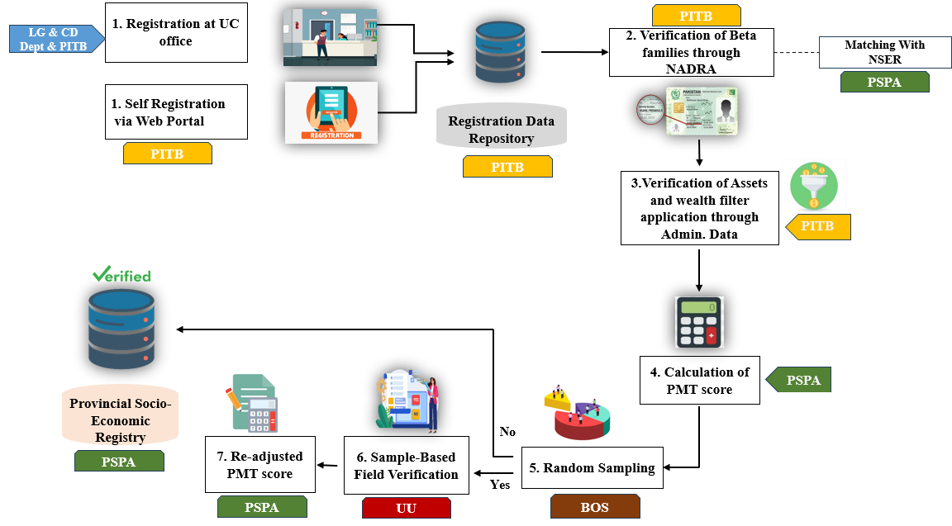
Process Flow

Slide 28
Exit Strategy
As the PSER is envisaged to be a dynamic registry that remains live and accurate at all times, it is imperative to continue the registration and up-dation activities after the completion of the PC-1.
For continuity and sustainability of the PSER, the registration desks at UC offices will continue to function and the field staff hired under the PSPA will be retained, as required (subject to government rules and policies), ensuring continued operations of the PSER after completion of project gestation.
Any reward to the UC staff, after the project is completed, will be decided separately.
The decision of retention of the staff at PMU/PIU and any change in their roles and responsibilities may be decided by the P&D Board at the time of completion of the project.

Slide 29
Overall Cost
Category | PSPA |  | PITB |  | U.Unit |  | BOS |  | Dist-admin |  |  | ISU
 | Allocation | % | Allocation | % | Allocation | % | Allocation | % | Allocation | % |  | Allocation | %
 | Amounts in million Rs.
HR Salaries | 892.79 | 27% | 272.54 | 43% | 204.66 | 90% | - | 0% | 780.00 | 97.50% | 97.50% | 36.21 | 44.27%
Reward & Honararium | 9.80 | 0% | - | 0% | - | 0% | - | 0%
Data Acquisition Charges | 967.60 | 29% | - | 0% | - | 0% | - | 0%
Communication | 426.00 | 13% | 2,.50 | 0% | 1.50 | 1% | - | 0% | 20.00 | 2.50% | 2.50%
Consultancies | 30.00 | 1% | - | 0% | - | 0% | - | 0%
Others Op. Exp. | 938.18 | 28% | 360.61 | 57% | 17.003 | 7% |  | 0% |  |  |  | 45.58 | 55.73%
Development of tools and Desk Testing of CAPI | - | 0% | - | 0% | - | 0% | 2.32 | 24%
Sampling | - | 0% | - | 0% | - | 0% | 0.99 | 10%
Supervision and monitoring | - | 0% | - | 0% | - | 0% | - | 0%
Training | - | 0% | - | 0% | - | 0% | 5.33 | 55%
Survey office and Institutional Arrangments | - | 0% | - | 0% | - | 0% | 0.776 | 8%
Contingency | 50.00 | 2% | - | 0% | 4.46 | 2% | 0.188 | 2%
Total | 3,314.361 | 100% | 635.66 | 100% | 227.63 | 100% | 9.618 | 100% | 800.00 | 100.00% | 100.00% | 81.79 | 100.00%

